Slide 1
Solving a Rubik’s Cube Using Reinforcement Learning
Selinam Setranah
Bikash Adhikari
Arthkumar Patel

Slide 2
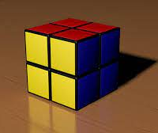
Introduction
A Rubik’s cube is a 3D puzzle that has 6 faces, each face usually has 4 stickers in a 2x2 layout

Slide 3
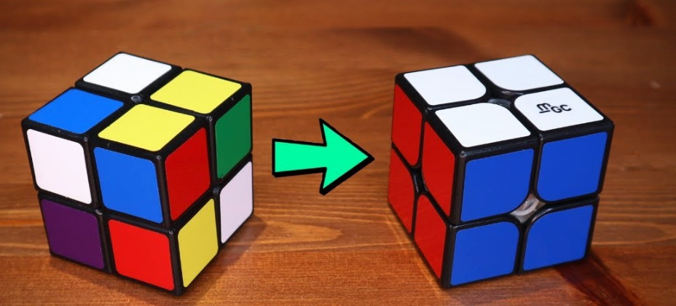
Objective
The objective of the puzzle is to achieve the solved state where each face only has a unique color.
Initial Stage
Final Stage

Slide 4
Approach
Python
Time Library for evaluating the speed
Reinforcement Learning (Breadth-First Search Algorithm)

Slide 5
Deliverables
PYTHON CODES
GITHUB LINK
PITCH DECK
POWERPOINT PRESENTATION

Slide 6
Evaluation Methodology
To check if the objective has been achieved, all faces of the Rubik’s cube must have one unique color.
Success Rate - Evaluate agent's performance in solving Rubik's Cube by measuring the percentage of successful attempts from a given scrambled state.
Time Count - Measure the agent's performance in solving Rubik's Cube by comparing the number of seconds taken by the agent to solve the cube from a given scrambled state.

Slide 7
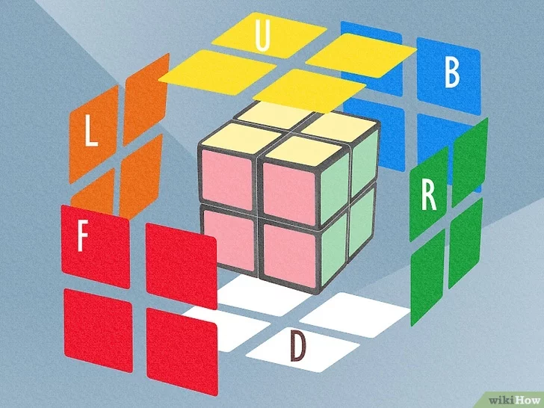
Demo
General overview of source code
Defining the rubik’s cube

Slide 8
Demo Continued..
General overview of source code
Solving the scrambled cube

Slide 9
Thank You

